Slide 1

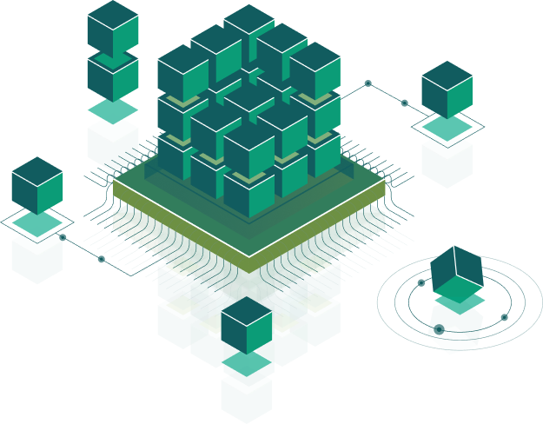
Data transfer protocols (REST, WebSockets)
Speaker: Dovgan
Name: Volodimir

Slide 2
Agenda
Create REST API project in Visual Studio
Create REST client
Introducing to WebSockets
Add WebSockets middleware to WebAPI

Slide 3

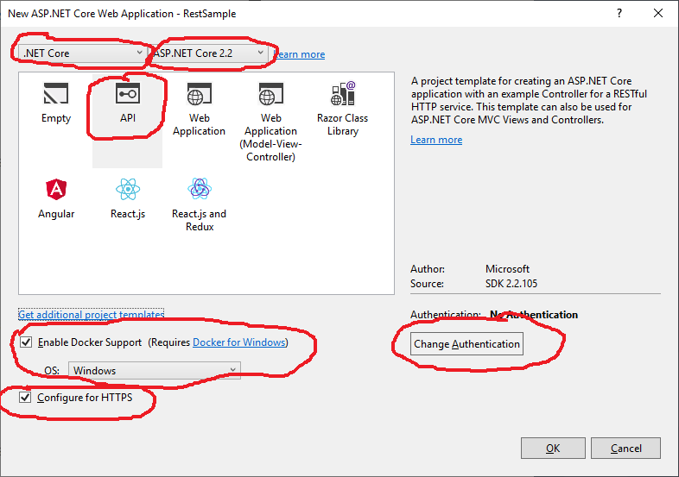
Create REST API project in Visual Studio

Slide 4
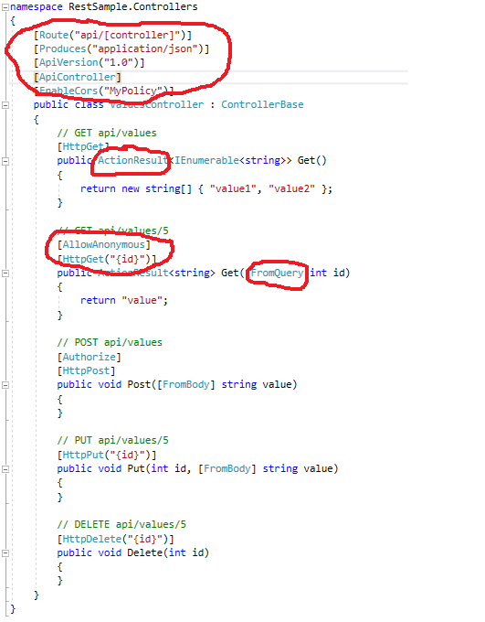
Create REST API project in Visual Studio

Slide 5
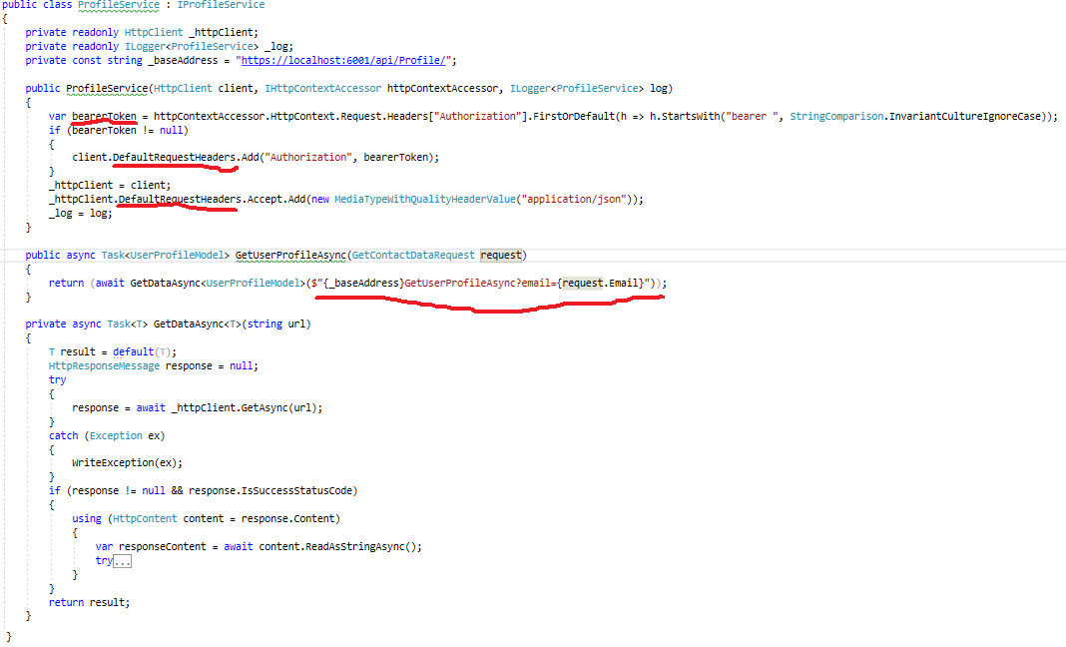

Create REST API client

Slide 6
Create REST API client

Slide 7
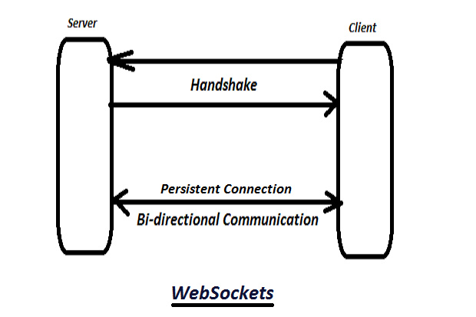
Introducing to WebSockets

Slide 8
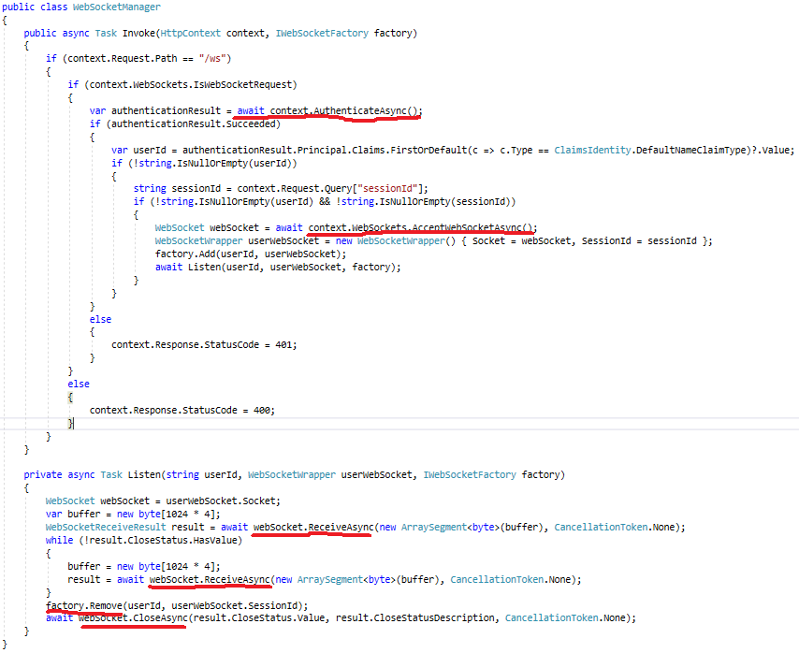
Add WebSockets middleware to WebAPI

Slide 9
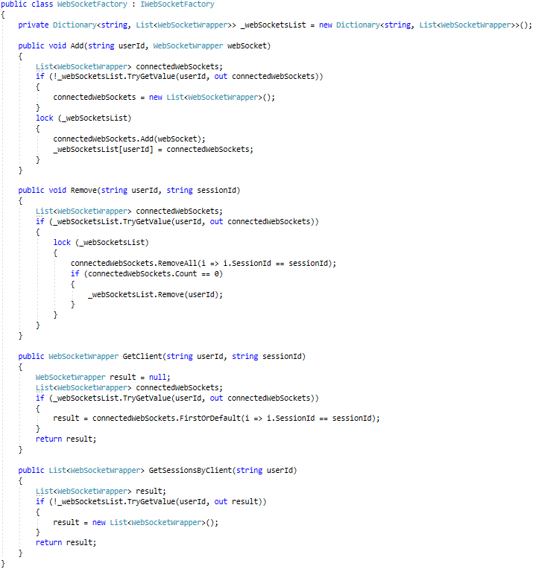
Add WebSockets middleware to WebAPI

Slide 10

Thank you!

